Slide 1
The sustainability of GIS data
A research into sustainable GIS data at drinking water companies.
Daan van Os August 2013
Notes:
Title page

Slide 2
Agenda
Why this research?
What has been researched?
How has this research been conducted?
What are the findings?
What are the conclusions and recommendations?
Notes:
The build up of this presentation. During this presentation I will explain why, what and how this research has been conducted.
I will share some recommendations and conclusions.

Slide 3
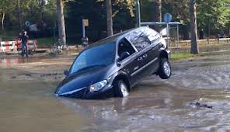
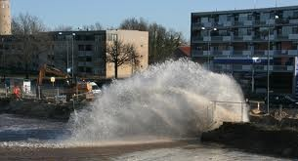
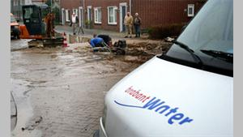
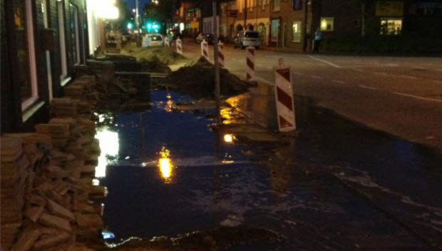
Reason
Dataproblems at asset registration
Use of GIS at decision making
Start of project to improve data
Notes:
Why this research?
Data problems at asset registration. Old data from different sources put together. High risk of excavation damage. Trying to improve effectiveness and efficiency. GIS data is used more and more to support decision making. Quality of the data becomes more important.
Improving data without knowing the cause of data degeneration does not guarantee long term data quality.

Slide 4
Research assignment
“What causes quality reduction of GIS data at Dutch drinking water companies and what are the possibilities to reduce this quality reduction, to ensure GIS data meet the future quality requirements?”
Notes:
What has been researched?
Cause of quality reduction
Possibilities to reduce quality reduction
Meeting future quality requirements

Slide 5
Research structure
Research into literature
Data quality
Sustainability
Data problems
Development of data problems
Production of GIS data
listing data problems
Top 4 data problems related to area, time or process
Area
Time
Relate data problems to the production process and make recommendations for sustainable data improvement
Notes:
How has this research been conducted?
Literature research to what is already known about data quality and sustainability
List of data problems at Dutch drinking water companies
Development of data problems where and when
Production process as cause of data problems

Slide 6
Literature
Sustainability of GIS data is the degree to which data in a GIS meet the current and future needs of the GIS users.
Data quality
Data quality is the level to which data are fit for purpose.
Sustainability
Sustainable development is development that meets the needs of the present without compromising the ability of future generations to meet their own needs.
Notes:
Quality is fitness for all purposes made of the data, including the likely future uses (English 1999).
Sustainable development can rather simply by conceptualized as paths of human progress which meet the needs and aspirations of the present generation without compromising the ability of future generations to meet their needs. (Brundtland 1987).
Quality reduction of GIS data is the reduction of fitness for purpose of GIS data to current and future needs of GIS users.
Sustainability of GIS data is the degree to which data in a GIS meets the current and future needs of the GIS users.

Slide 7
Problem inventory
Inventory at all Dutch drinking water companies.
Top four national data problems:
Positional uncertainty
Unknown building year
Wrong combination of material and building year
Wrong material
Notes:
What has been found?
A structured list is used to draw up an inventory of the data problems at all Dutch drinking water companies.
Data problems undependable of systems, so intrinsic or contextual problems.
100% response, 90% indicates knowing data problems.
Positional uncertainty at 70%. At 40% most important problem. Mains on an other location as registered.
Unknown building year, present at 80%, at 30% most important problem. The year the main is constructed is unknown.
Wrong combination, present at 60%, at10% most important problem. Combination of material en building year are wrong. For instance PVC build in 1920.
Wrong material, present at 50%, at10% most important problem. Different material than registered.
Mains, longer than 50 meters, where the location information is not gain in RD coordinates and where no measurements are used to register the location in relation to topographic objects, are suspect of positional uncertainty.
A building year is unknown if the database value is 1800 or 1900.
The material is wrong if the material used in the real world is different than the registered material.

Slide 8
Notes:
Suspicion of wrong registration. The mains are not where they are suspected according to the registration.
Map representing mains whit suspicion of uncertain lociation. Location does not clearify couse.

Slide 9
Percentage uncertain registration
Notes:
Location does not clarify a possible cause. Time was next. The graph indicates certain years in which many mains are constructed with an uncertain location. Especially at the start of last and of this century.
Percentage of main lengths per building year. 1800, 1870 and 1901 are PVC mains. This means the building year is wrong. Cause of the uncertain registration at the start of this century is not recording the method of collecting the locational information. Change from relative to absolute recording. From tape measure to GPS.

Slide 10
Notes:
Mains having an unknown building year. Areas taken over by Brabant Water or its predecessors from communial utility companies.

Slide 11
Wrong combination of material and building year
Notes:
Graphs show amount of meters mains having a wrong combination of material and building year. At the top sorted per building year at the bottem sorted per community.
Cast iron is used till the sixties of last century. Eindhoven, Tilburg and Vught stand out having cast iron registration til 1990. The same kind of graphs are made for other materials PVC, AC, PE and PVCBV.
By making these graphs for all materials, time and location of wrong combinations is found. Trough which a possible cause of wrong registration has been found.

Slide 12
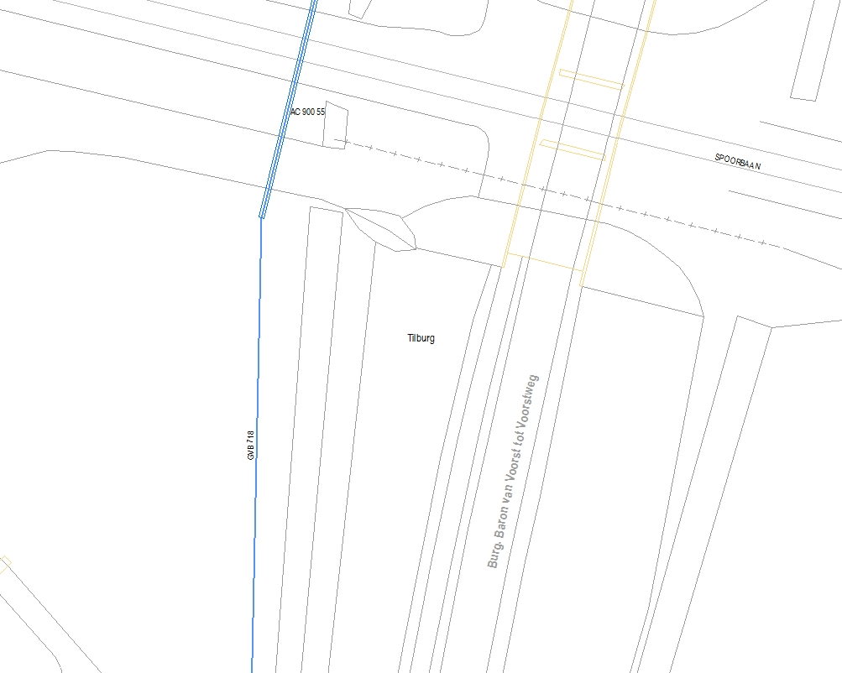
Wrong material
Notes:
The material of the main differs in real world from the registration.
At the left hand side a old map showing an annotation 700GVK. At the right after conversion a label GVB 718. Clearly a conversion mistake.

Slide 13
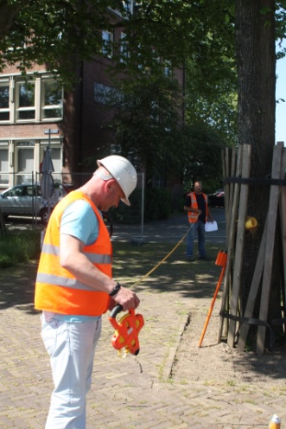
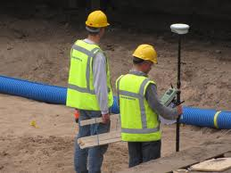
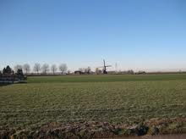
Causes of data problems
Uncertain location
Absence of measurement
No indication of used method
Unknown building year
Attribute not entered when merging databases
Wrong combination of material and building year
Input error
No registration of new material
Wrong material
Conversion error
Notes:
Uncertain location of mains
1% of distribution mains and 10% of transportation mains. Measurement not to solid points, no measurements.
Measured in RD without indication in the geo quality attribute.
Unknown building year
Not registered by predecessors and not entered at take over.
Wrong combination of material and building year investigated for PVC, AC, GIJ, PE and PVCBV
Input errors wrong building year.
No registration in change from cast iron to ductile iron. No registration in change from PVC to PVCBV.
Wrong material
Wrong conversion. Glass fiber reinforced plastic (GVK) converted to Glass fiber reinforced concrete (GVB) and PVC 107 converted to ST 107

Slide 14
Production process of GIS data
Registration of mains is a process.
Production process in relation to quality.
ISO 9000 quality principles used on registration of mains.
By improving the production process, the data quality improves as well.
Notes:
Registration process collect, write down, check, input and again check of data. This process is comparable with a production process. The quality principles of a production process are applicable to the process of registration of mains. Found causes of problems are related to this process to find way of preventing new problems. ISO 9000 quality principles are applicable to data quality.

Slide 15
Abstract
Data problem | Cause | Recommandation
Positional uncertainty | No measurements Unclear method New method of working | Accuracy demand Check on location according demand
Unknown building year | Empty attribute | Fill in new attributes at existing objects. Input through list of options
Wrong combination of attributes | Input errors Way of registration | Knowledge preservation Involve constructor at revision Determine the consequenses of new procedure to registration
Wrong material | Conversion errors by lack of knowledge | Involve end users at conversion
Notes:
Abstract of problem, cause and solution to future data quality.
Table showing errors, causes and solutions.
By relating the cause of the problem to the process it is possible to make recommendations for data improvement based on the quality principles.

Slide 16
Discussion and conclusions
Nine out of 179 quality aspects are used.
In finding the cause of data problems, the procedures and data of Brabant Water are used.
Quality principles from ISO 9000 can be used to make data quality sustainable.
Notes:
Repeat research question and answer the research question.
“What causes quality reduction of GIS data at Dutch drinking water companies and what are the possibilities to reduce this quality reduction, to ensure GIS data meets the future quality requirements?”
Causes are found by relating data to area and time.
Only intrinsic and contextual quality aspects are used. Procedures and data of Brabant Water are used. Other data or procedures may result in other causes.
Recommendations for sustainable GIS data proceed from ISO 9000 quality principles.

Slide 17
Thank you for your attention!

